Slide 1
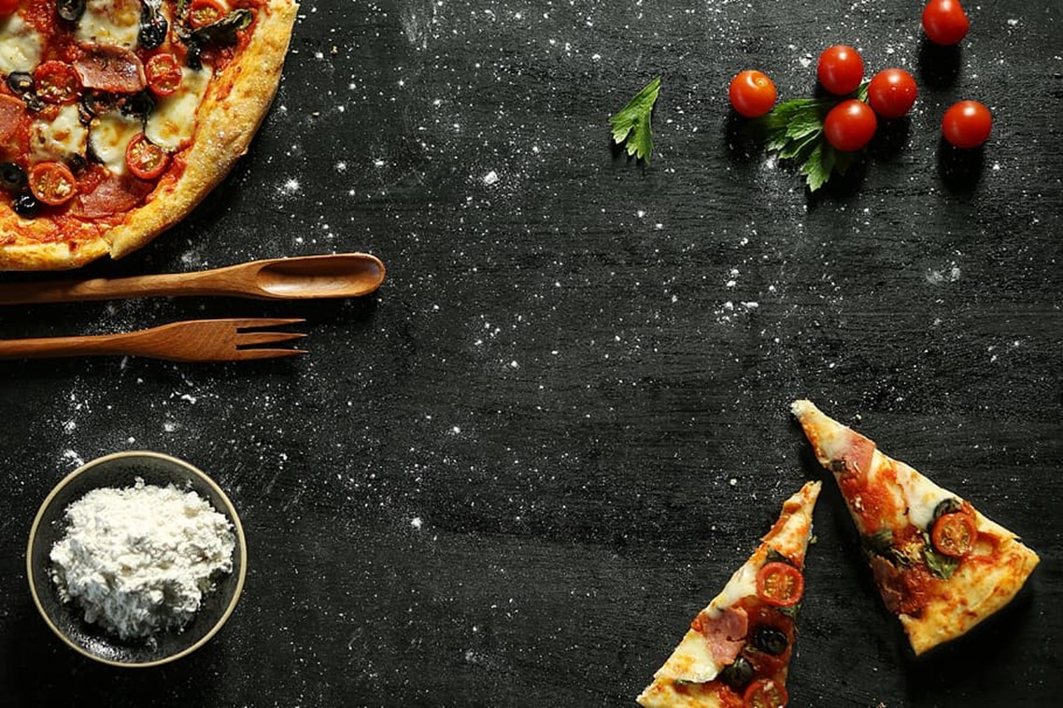

PIZZA PLACE SALES ANALYSIS
​Akash Raj Nigam

Slide 2

Contents
1
2
3
4
5
Introduction
Goals and KPIs
Recommended Analysis
Suggestions
Conclusion

Slide 3


Introduction
Scenario:
Pizza Place is experiencing a steady drop in customer numbers over the past year, which has negatively affected its sales and profitability. The company has gathered a year’s worth of data on various aspects of its business, such as date and time of each order and the pizzas served, with additional details on the type, size, quantity, price, and ingredients.
Problem Statement:
Using the data the company wants to analyze this data to identify the root causes of the customer decline, the current and potential customer segments, and the opportunities to enhance customer satisfaction and retention. The ultimate goal is to increase customer traffic and sales by implementing data-driven strategies.

Slide 4
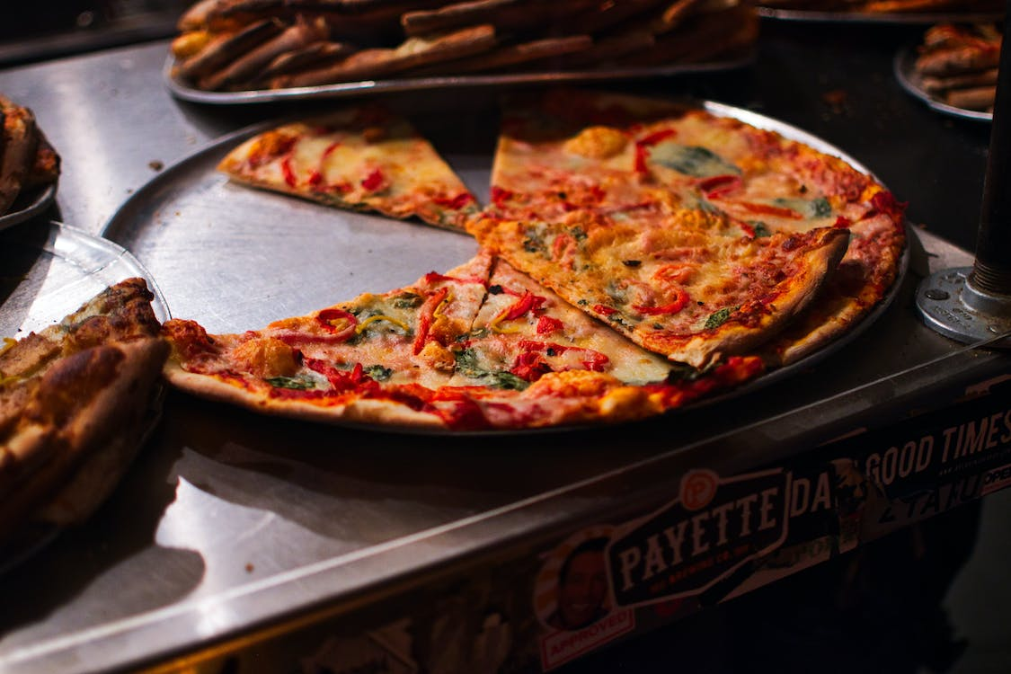
Goals & KPIs
Goals:
Finding insights as to why the customers are declining.
Finding customers’ preferences and their buying patterns to understand their psychology.
Providing data driven solutions to increase the sales of Pizza within a year.
KPIs:
Total revenue of the company for the year.
Average number of customers buying pizzas.
Peak months and hours for better sales.

Slide 5
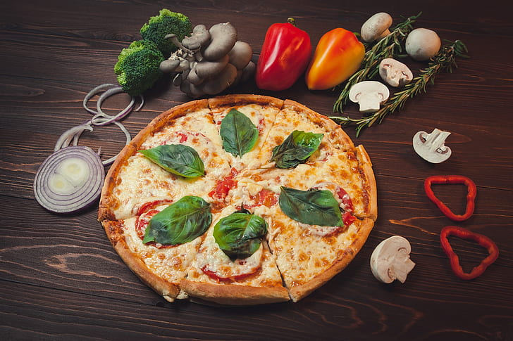
Recommended Analysis

Slide 6

1. Average Customers Per Day
Months | Average of order_details_id
Jan | 2078.5
Feb | 6102.5
Mar | 10141.5
Apr | 14268
May | 18421
Jun | 22553
Jul | 26716
Aug | 30913.5
Sep | 34870
Oct | 38678
Nov | 42669
Dec | 46691
Grand Total | 24310.5
Average Customers | 66
On average there are 66 customers each day.

Slide 7

2. Peak Hours Of The Day
“
In daytime 12PM to 1PM is the busiest interval.
In evening 5PM to 6PM is the most selling time.

Slide 8
3. Revenue Analysis
Graph 1 shows Revenue Per Month where
July has highest revenue of ₹72557.90.
October has least revenue of ₹64027.60.
March – July show increase in sales.
Graph 2 shows total revenue of year 2015 which is ₹817860.05

Slide 9
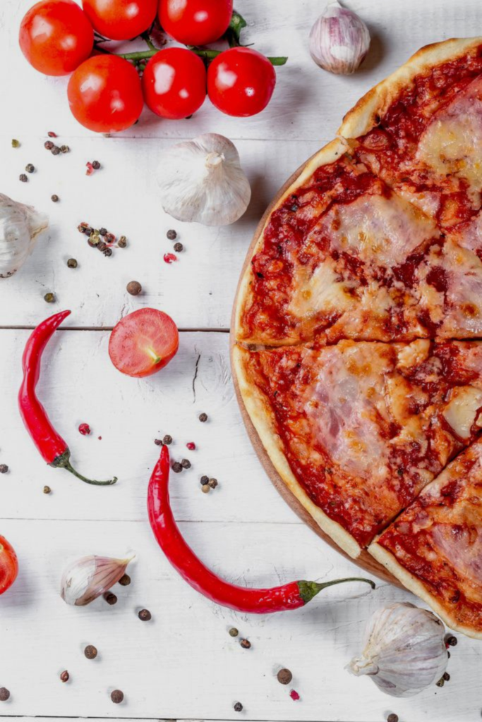
4.Monthly & Seasonal Sales Analysis
GRAPH 1
GRAPH 2
GRAPH 1:
This graph shows monthly orders for 2015.
July month has most number of sales followed by May, then March.
September & October have least number of sales.
GRAPH 2:
This graph shows the seasonality or the seasons having most sales.
Summer, Spring & Rainy seasons have most sales.

Slide 10
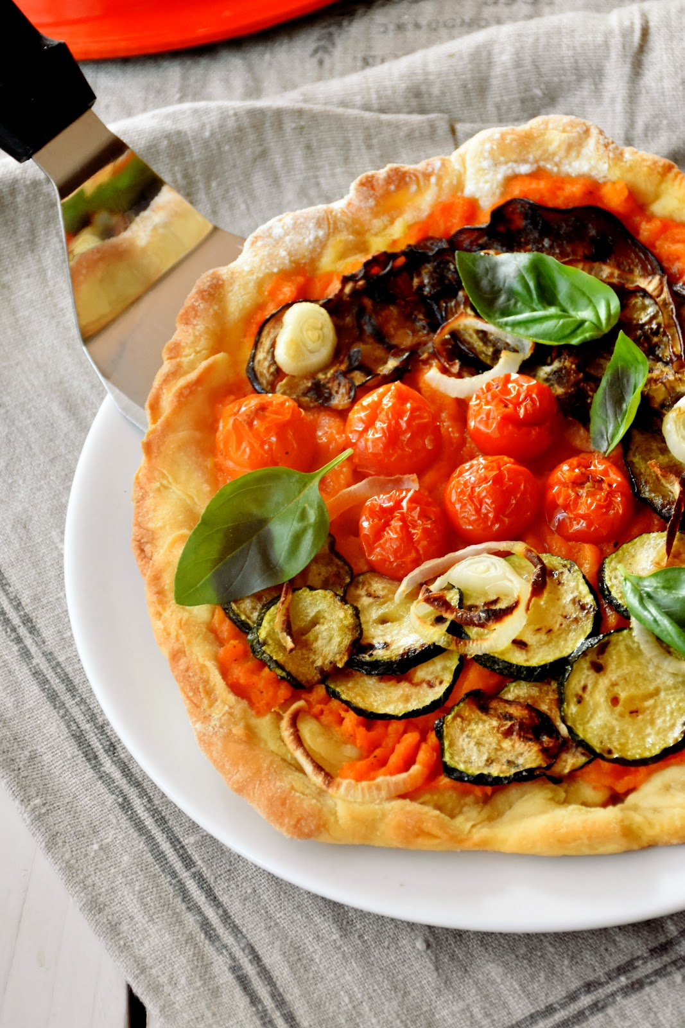

Suggestions
Seasonal specials: You can create seasonal specials that match the weather, holidays, or events of the season.
Promotions: You can run promotions that offer discounts, freebies, or rewards to your customers.
Online ordering and delivery: You can enable online ordering and delivery for your pizza place, using your own website or a third-party platform.
Local marketing: You can market your pizza place to your local community, using various channels and strategies. For example, you can partner with local businesses, schools, or organizations to offer catering, discounts, or sponsorships.

Slide 11

Conclusion
The pizza place can use data analysis to improve its business by understanding its customer traffic, pizza orders, sales revenue, and menu preferences, and applying data-driven strategies accordingly.

Slide 12

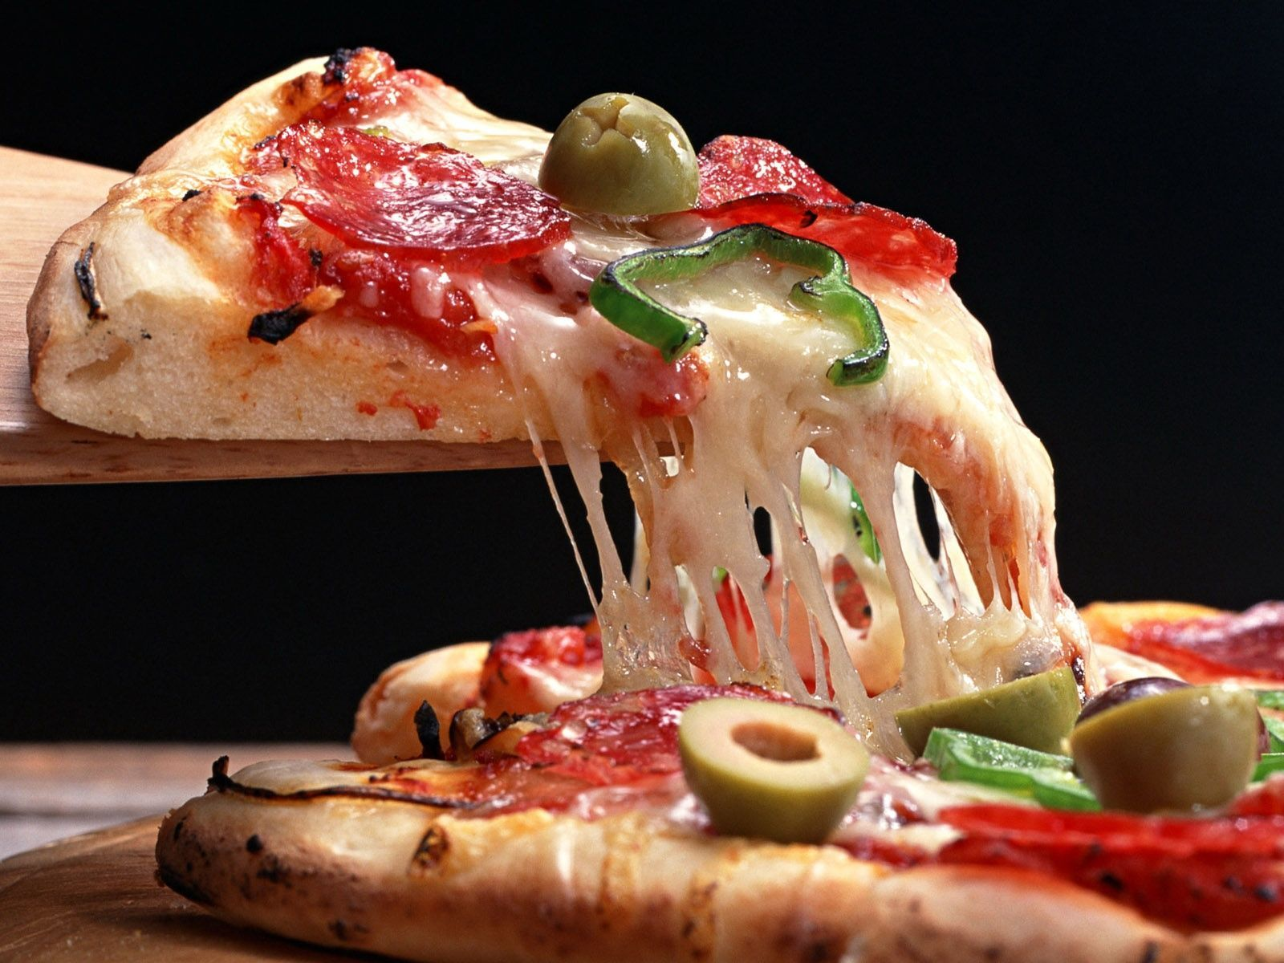
Thank you
Akash Raj Nigam
Gmail: akashrajnigam38@gmail.com
LinkedIn: https://www.linkedin.com/in/akash-raj-nigam-46b348192
Peerlist: https://peerlist.io/akashrajnigam

